Slide 1
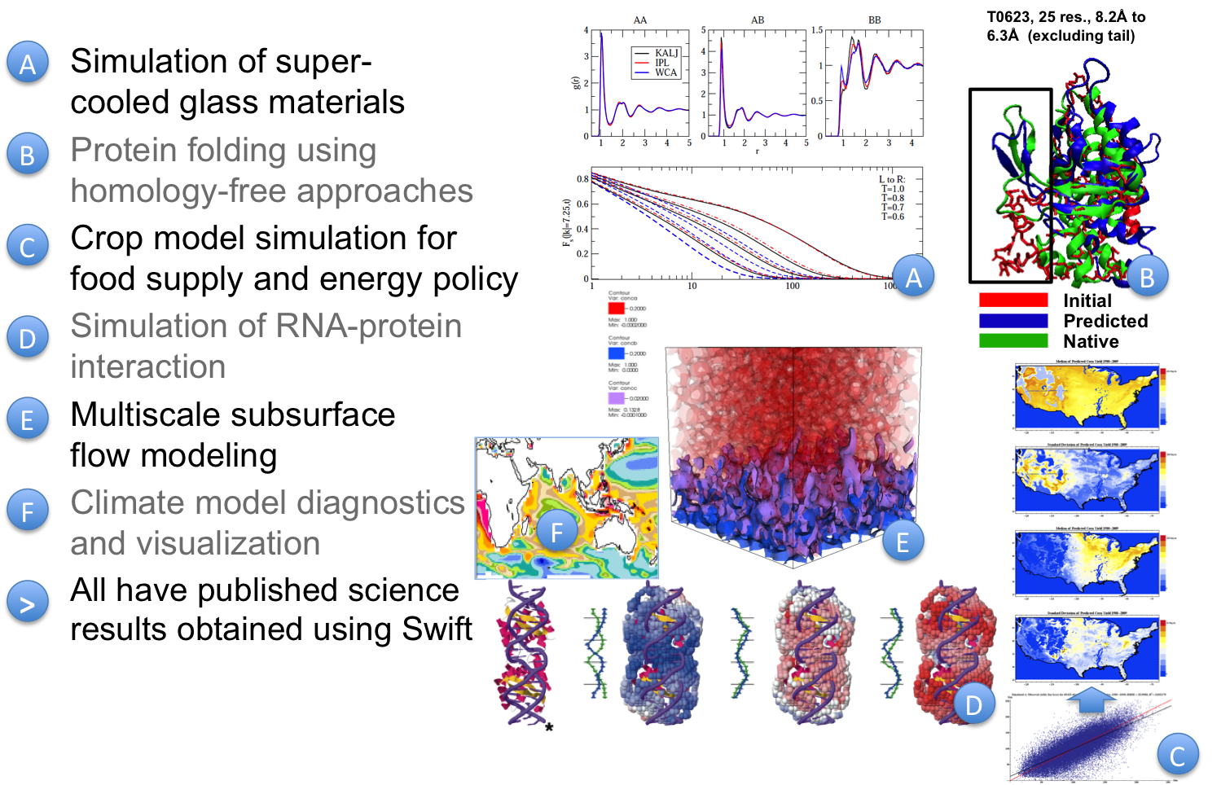
http://swift-lang.org
Parallel Scripting Ecosystem for Science and Engineering Workflow
University of Chicago (Y. Babuji, A. Brizius, R. Madduri, M. Wilde, J. Wozniak), Arizona State (G. Lindberg), Colorado State (M. McCullagh), University of Illinois (D. Katz), College of New Jersey (J. Baker), Notre Dame (M. Wayne), University of Tampa (O. Sode)
Problem: How to compose large parallel workflows from ordinary application programs, to run fast and easily on diverse parallel resource?
Example: An image processing pipeline for land-use data from the MODIS satellite instrument…
Solution: a compact, portable, parallel Swift script:
foreach raw,i in rawFiles {
land[i] = landUse(raw,1);
colorFiles[i] = colorize(raw);
}
(topTiles, topFiles, topColors) =
analyze(land, landType, nSelect);
gridMap = mark(topTiles);
montage = assemble(topFiles,colorFiles,webDir);
`
`
Run Swift across diverse parallel platforms
Swift/E: An ecosystem for scientific workflow
GitHub etc.
Galaxy
Jupyter
Swift Interpreters
Workflow
Net (SWAN)
Py
R
…
Provenance
Resource & IO Drivers
SQL
json
Clouds
HPC & SC
Multicore & GPU
Globus
SaaS
GridFTP
Swift-E Integrates synergistic software elements to form a rich ecosystem for productive and collaborative workflow execution and sharing.
Swift is a fully parallel scripting language
Composes apps that pass files or objects
Easy to write: a “little”, high-level language
Short Swift scripts can do large-scale work
Easy to run: on clusters, clouds and grids
Sends work to XSEDE, Amazon, OSG, Cray
Fast and highly parallel
Runs millions of tasks on thousands of cores
hundreds to millions of tasks per second
Use Swift across diverse science domains
This research has been supported in part by NSF grants ACI-1550588, OCI-1148443, OCI-1007115 & PHY-1219444 and the DOE ASCR X-Stack Program.

